Slide 1

Logical Increments
PC Part Picker System Build Review
Yisela Alvarez Trentini
03.08.2018

Slide 2
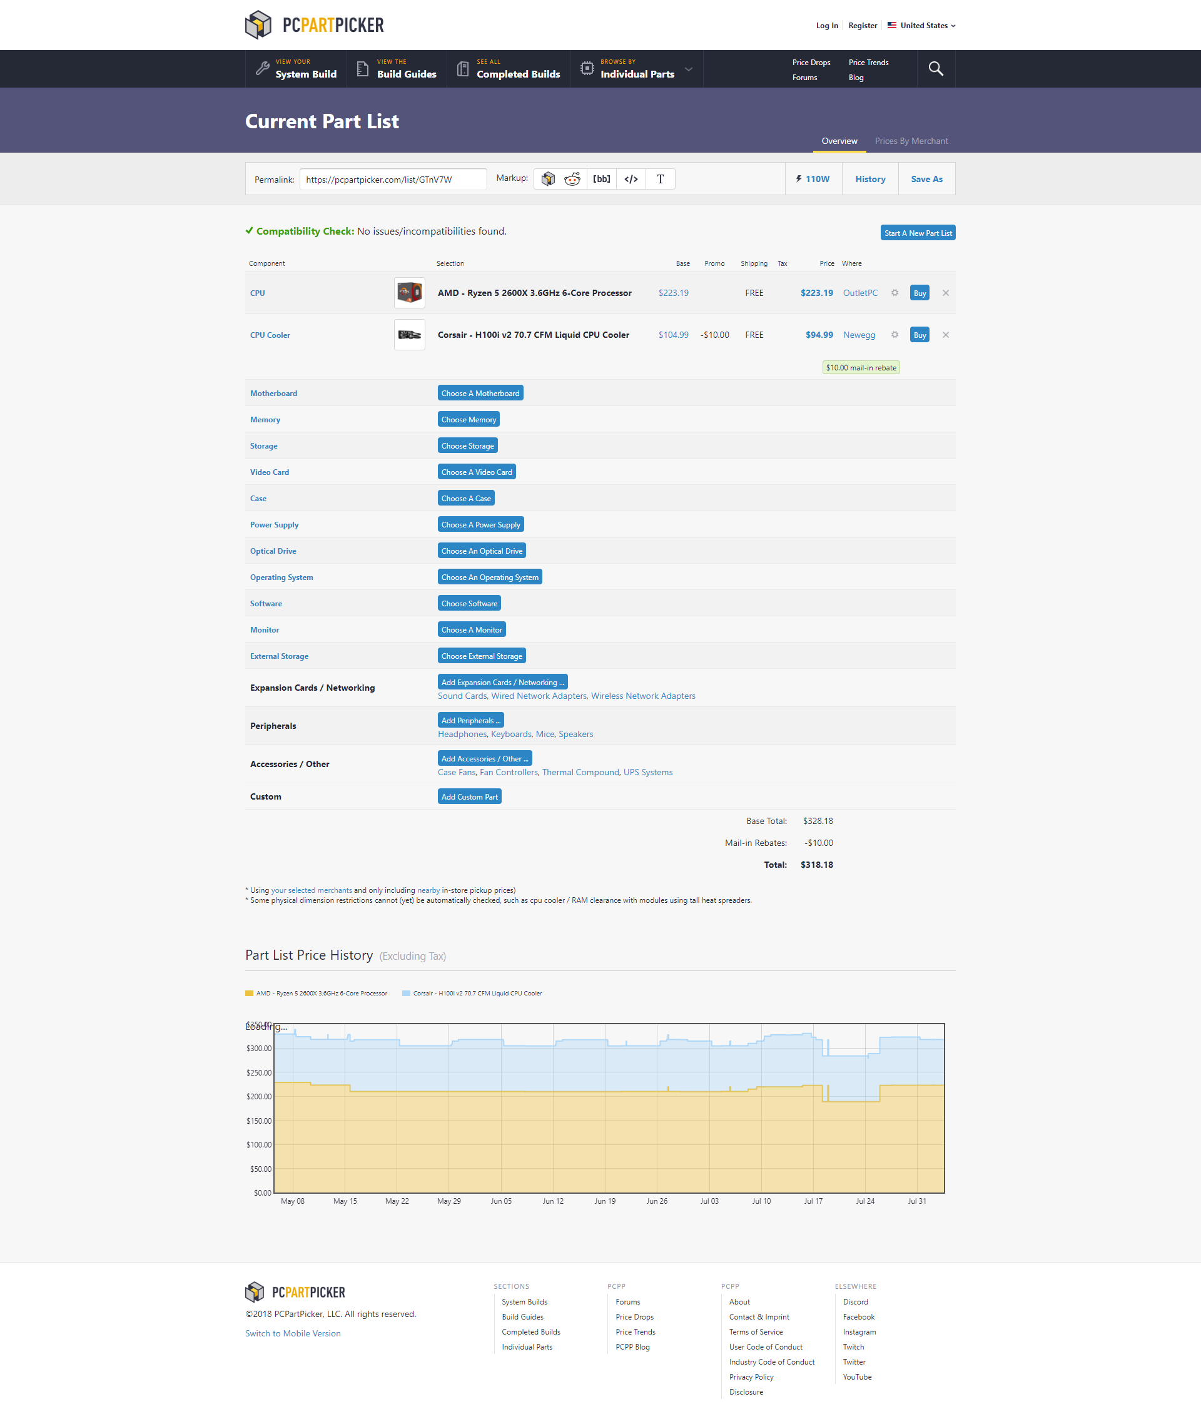
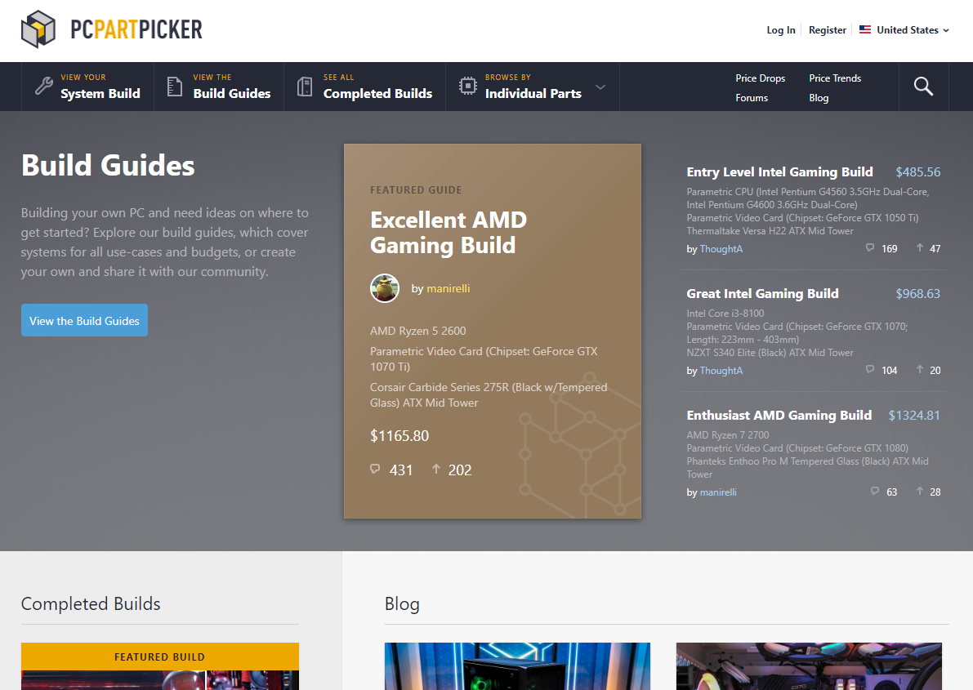
PC Part Picker - System Build

Slide 3
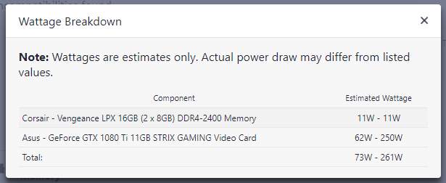
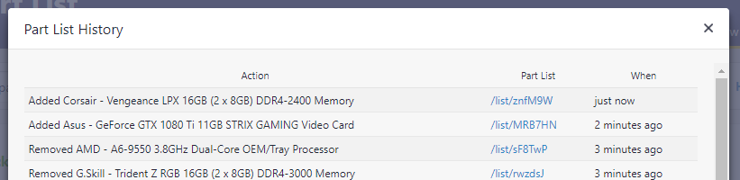
TOP AREA FEATURES
Share Area
Total power consumption
Activity

Slide 4
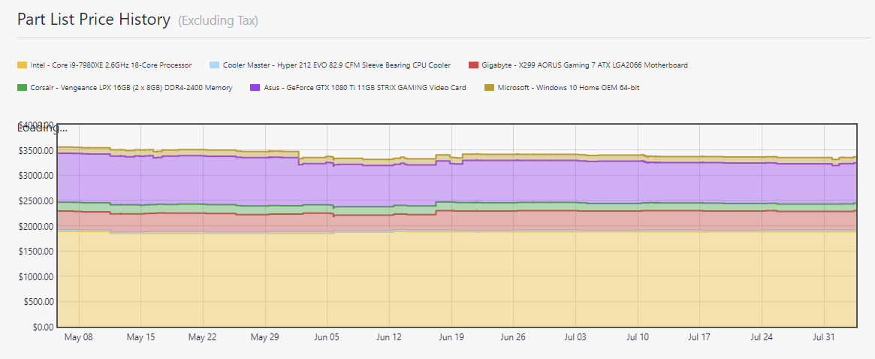
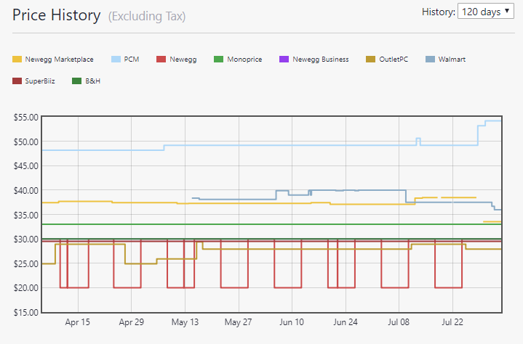
PRICE HISTORY
All parts - Average
1 Part - Sellers

Slide 5
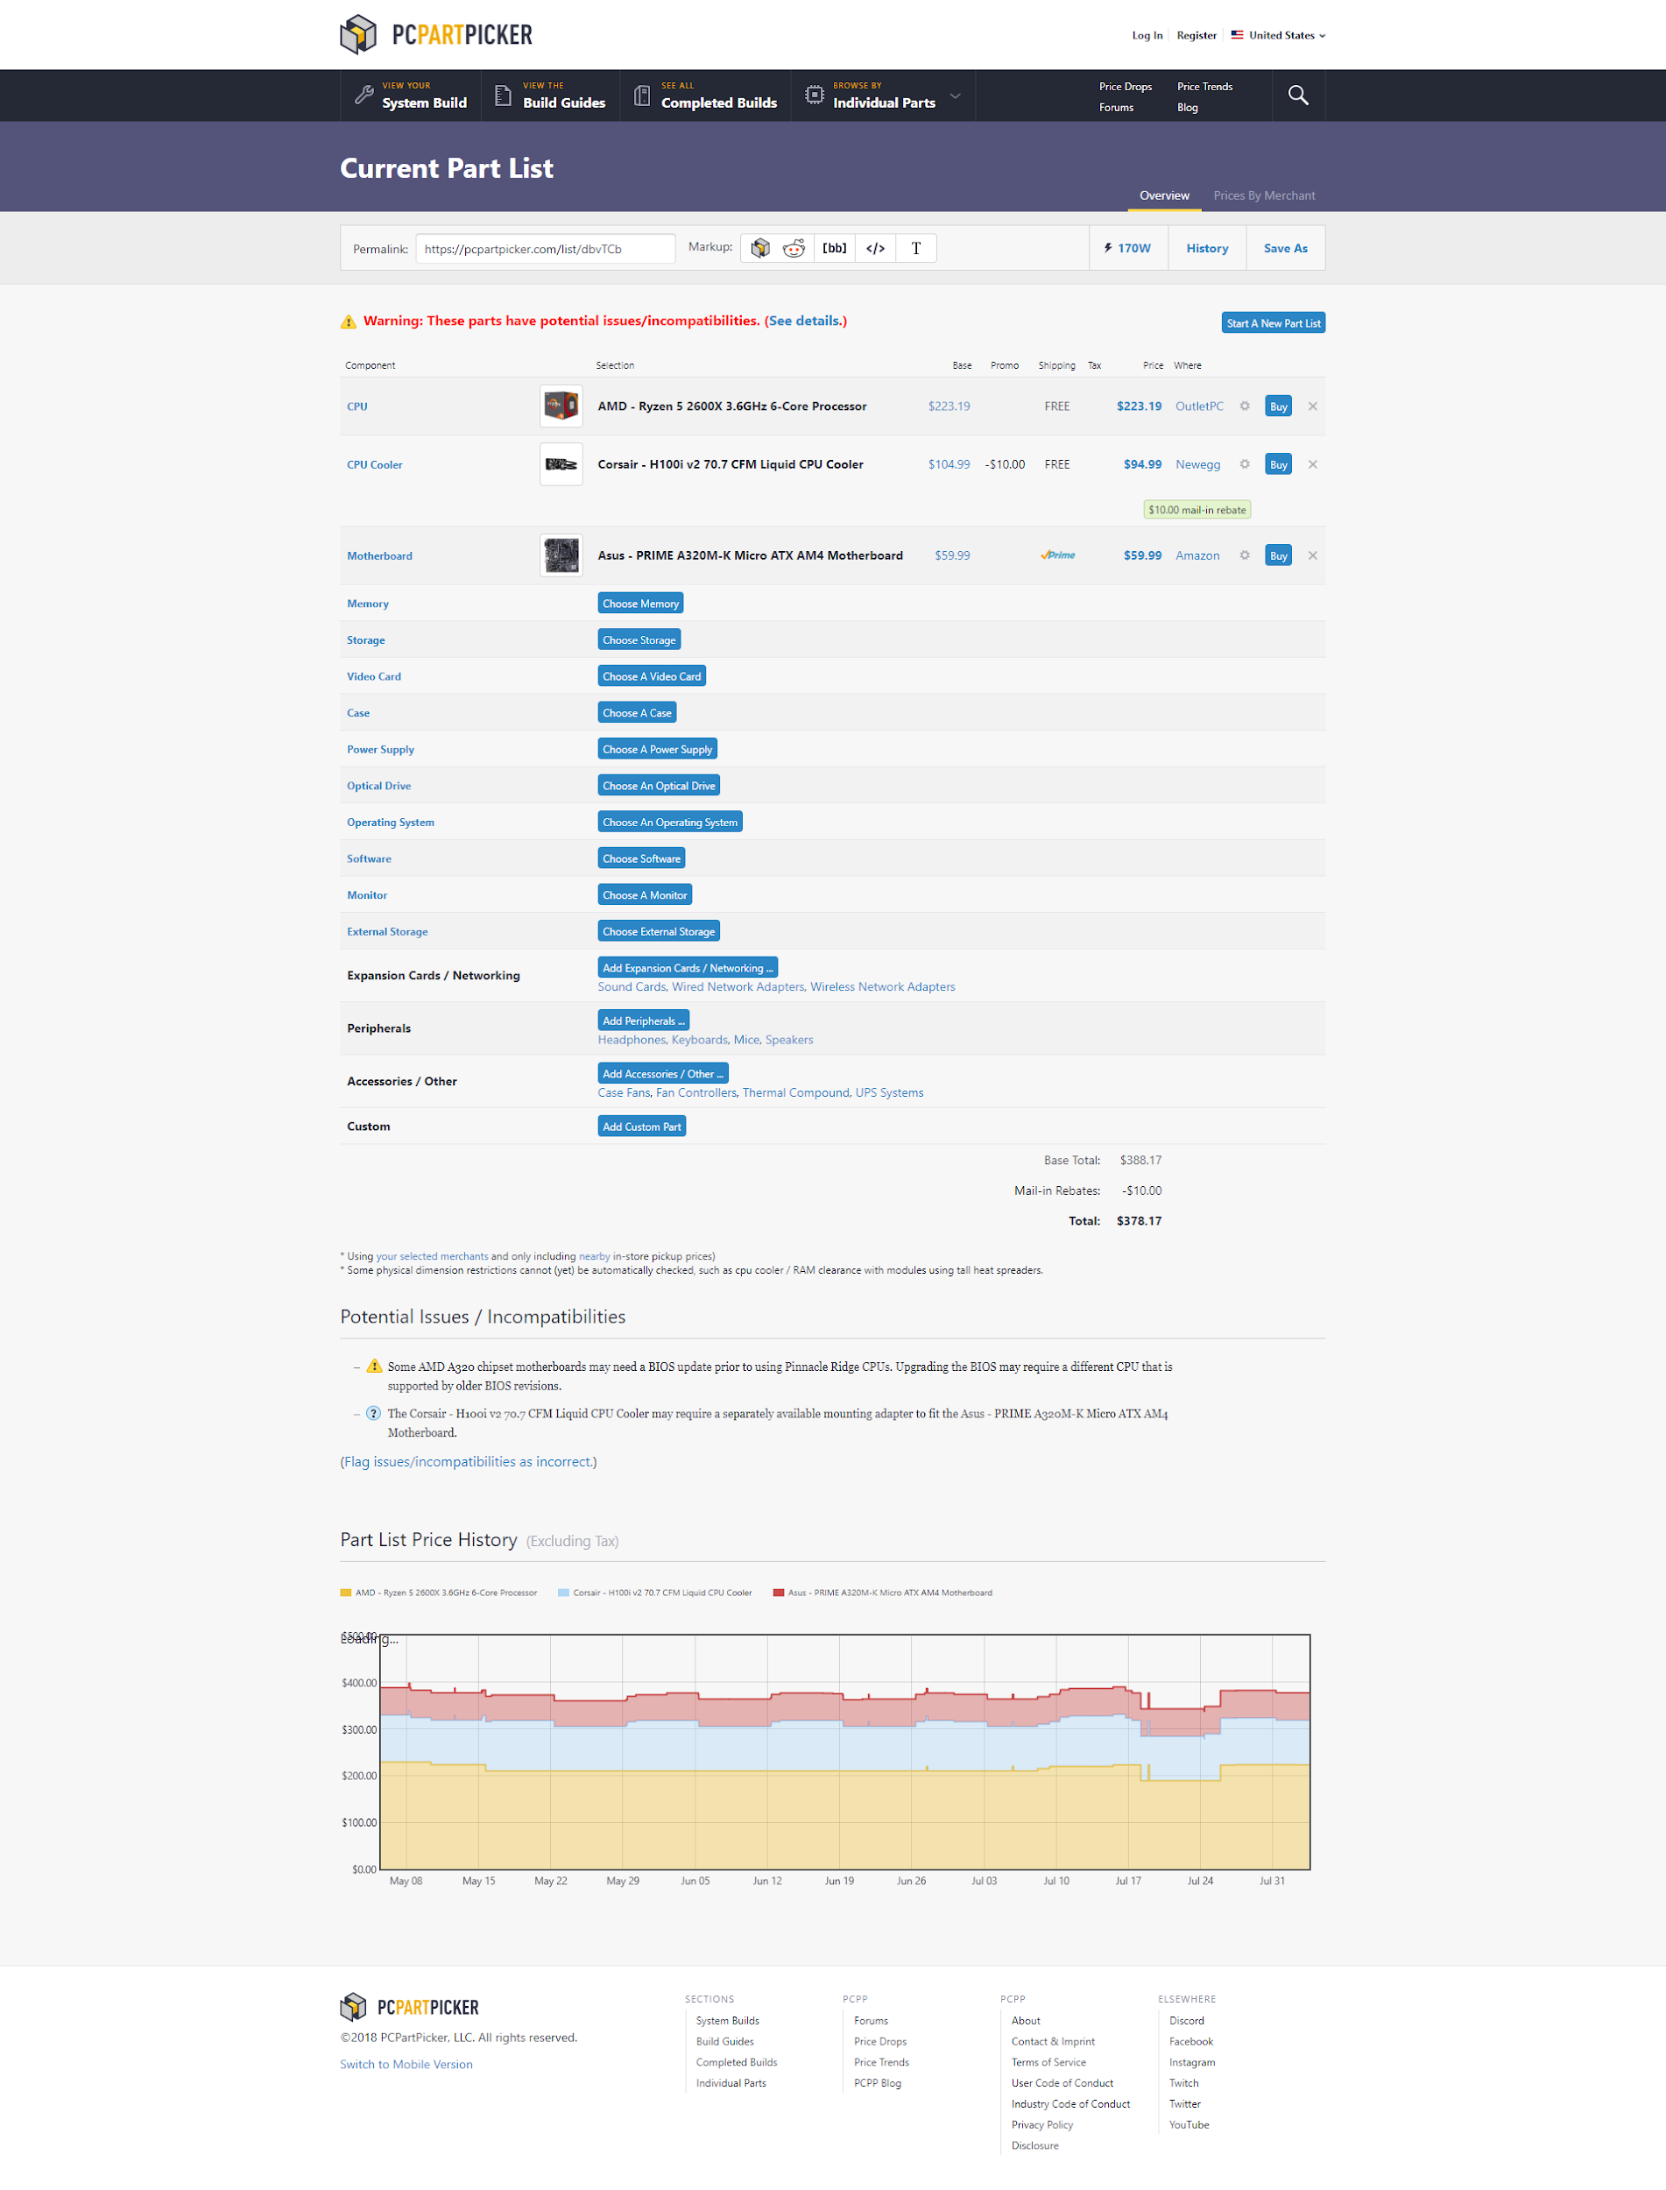
CONFLICT

Slide 6
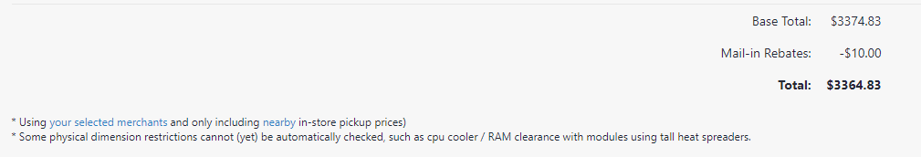
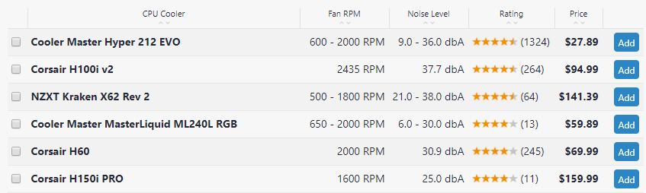
REBATE
Rebates show up in the part and the final price, but not in the parts list!

Slide 7
PRICE DETAILS
Taxes?
Other discounts?

Slide 8
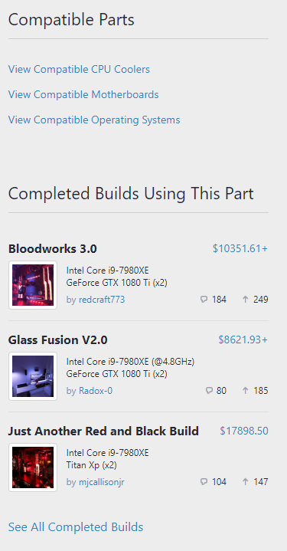
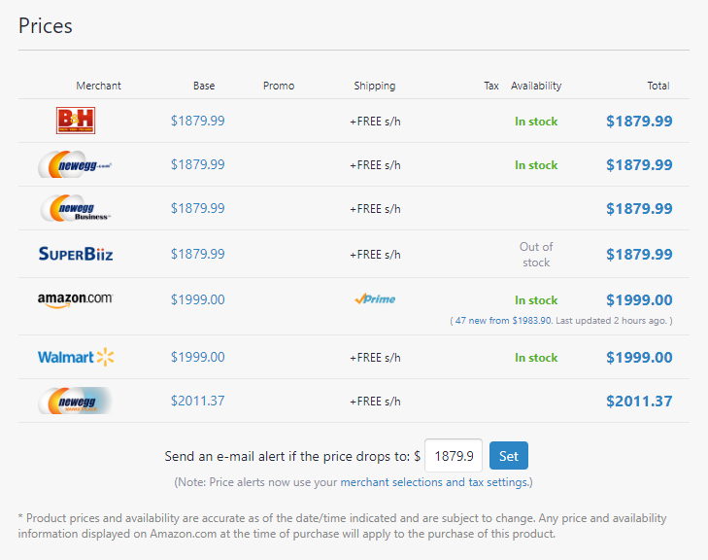
SUGGESTING STUFF (parts level)

Slide 9
CONS
All buttons look the same, but is “Start a new list” as important as “Add parts”? SLIDE
Products open in reload, and although the functionality remains (you can “Add” parts and they will show up in the list), the context is lost. Would be better to do it in place.
No options to change prices - any available discounts?
Potential issues are out of sight as the user loads parts. There is a nice notification on top, but nothing if you are scrolling in the middle of the page. Issues use a different font.
Deleting elements makes the table jump
No loading indicators for possible delays
No tooltips for buttons! (for example the top area bar)
Part page: Buttons for Favorites and Inventory don’t do anything, or don’t give any feedback to the user of what has happened. SLIDE
No buttons to go back from a parts/part page (you can “Add”, but you can’t cancel or just return) SLIDE

Slide 10
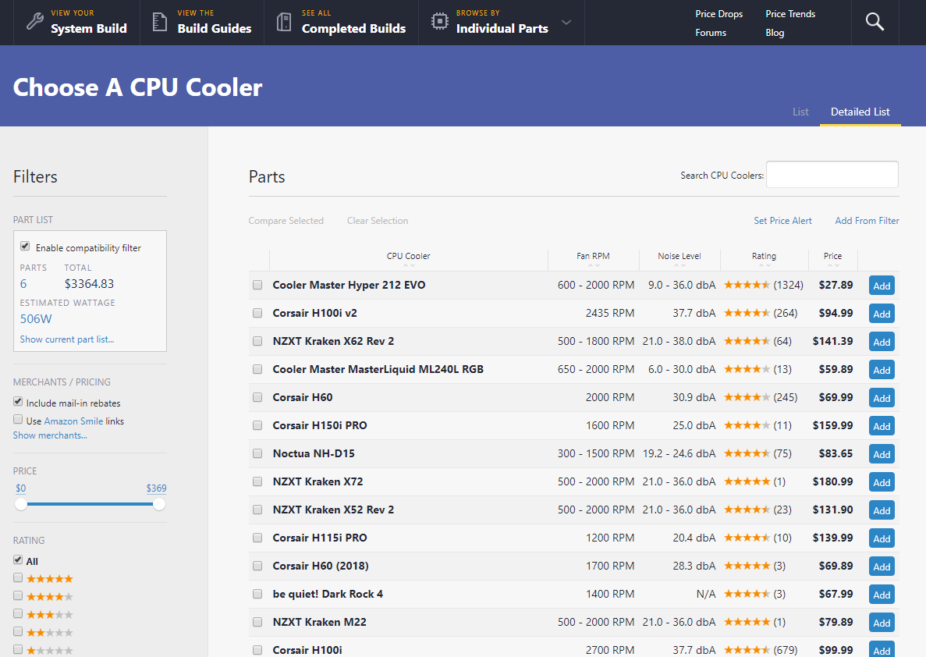
No way to go back to App

Slide 11
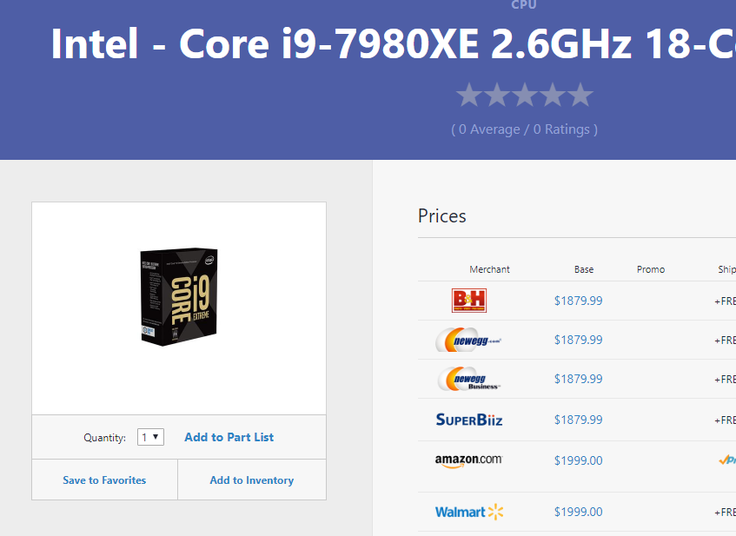
No feedback for buttons

Slide 12
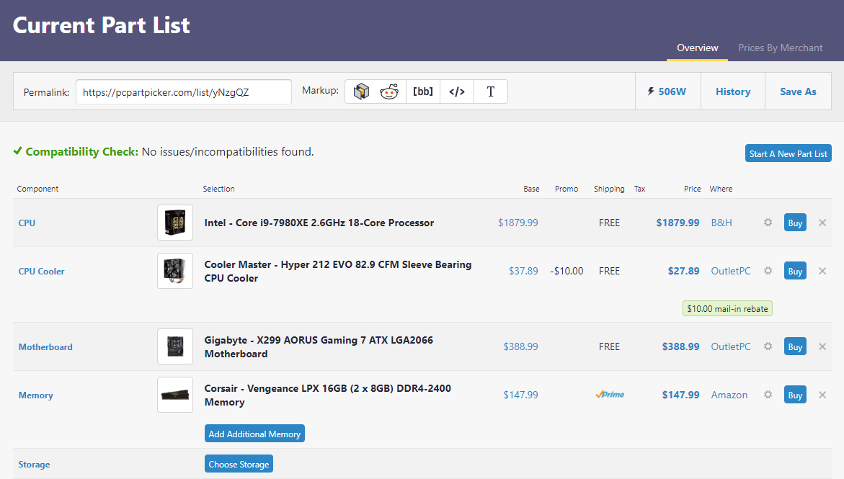
All buttons look the same - no hierarchy

Slide 13
Thank You!

